Slide 1
GOES-16 Cloud Mask and Cloud Top Properties in AWIPS-2
NWS/OBS Update to Provisional PS-PVR
Feb 16, 2018

Slide 2
GOES-16 Cloud Mask, Cloud Top Properties in AWIPS-2
Fielded AWIPS-2 baseline handles ingest and display of the products
Style rules are modified to handle display units (e.g. cloud top heights in Ft)
NWS began sending Cloud Mask, Cloud Top Properties via SBN in June 2017:
Cloud Top Height (F, C, M)
Cloud Top Pressure (F, C)
Cloud Top Temperature (F, M)
Clear Sky Mask (F, C, M)
Examples of each are in the following slides

Slide 3
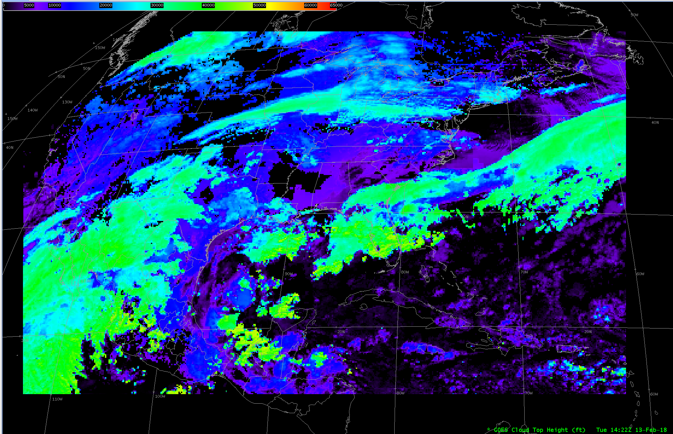
GOES-16 Cloud Top Height (Ft)
14:22 Z 13 Feb 2018

Slide 4
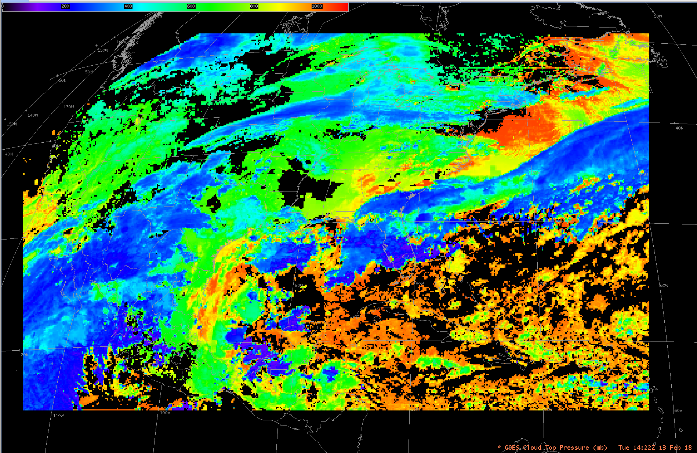
GOES-16 Cloud Top Pressure (hPa)
14:22 Z 13 Feb 2018

Slide 5
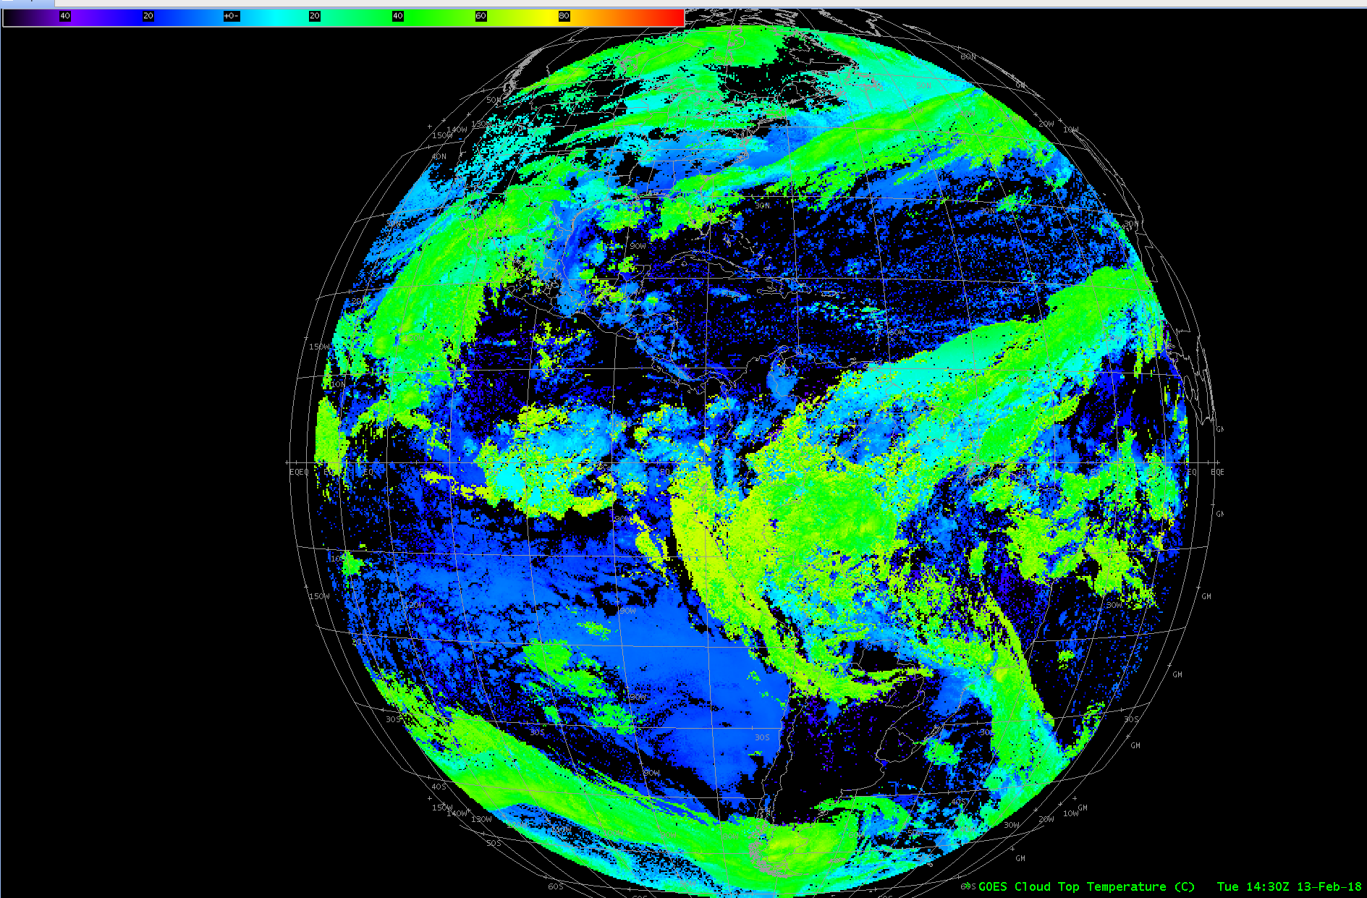
GOES-16 Cloud Top Temperature (degC)
14:30 Z 13 Feb 2018

Slide 6
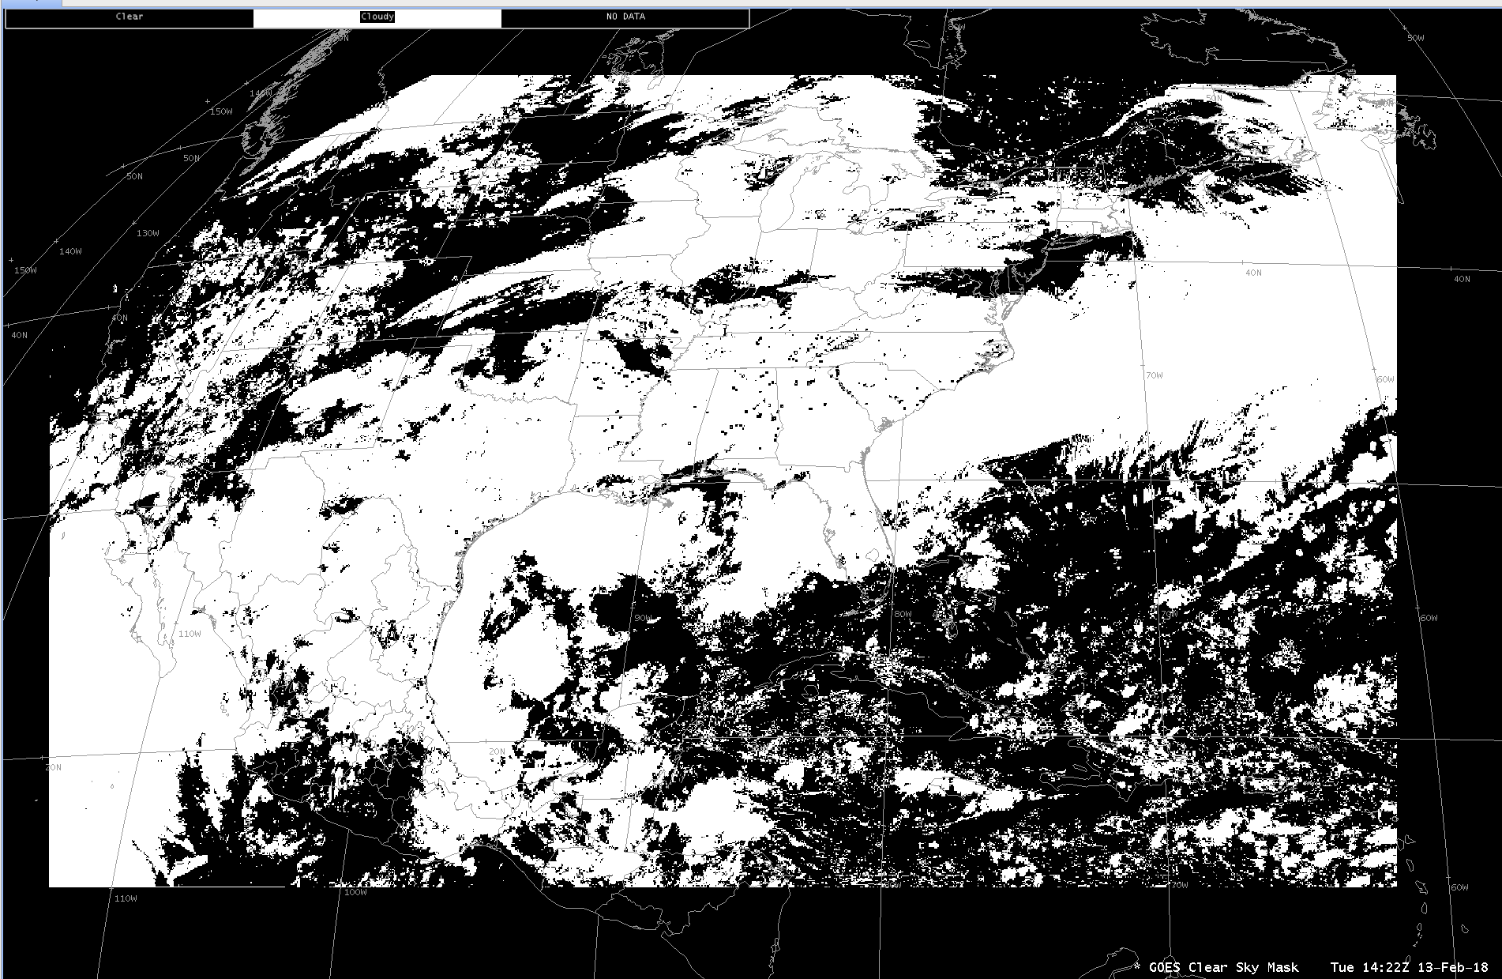
GOES-16 Clear Sky Mask
14:22 Z 13 Feb 2018

Slide 7
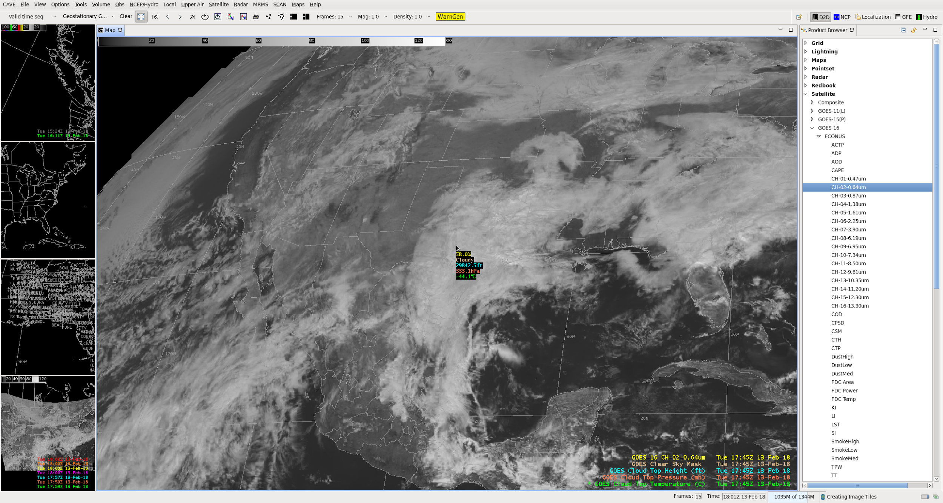
GOES-16 CH-02 with Cloud Product Sampling and Menus
Pressure: 333 hPa
Temp: -44.1 C
Height: 29,842 Ft
17:45 Z 13 Feb 2018

Slide 8
Questions?

